Slide 1
City of Ridgeland Public Space and Special Event Recycling Programs Informational Brief
John M. McCollum, Public Works Director

Slide 2
Programs
Recycling drop off Points
Event Recycling
Interactive Recycling Containers
Water Bottle fillers and outdoor fountains
Special Event Application and permit
Community Out Reach
Funding

Slide 3
Mission (who, when, what, where and why)
The City of Ridgeland in cooperation with the Department of Environmental Quality, no later than October 31, 2011 will provide recycling facilities in public places in order to provide recycling opportunities where curbside pickup is not available and to provide these opportunities at events and public places.

Slide 4
Execution (How)
The City of Ridgeland Public Works Department will install, construct and maintain a 30 yard recycling container, pad and signage.
Tasks for the City of Ridgeland
Do a cost estimate
Conduct a site survey to see if there is enough space for facilities
Determine if the governing body is willing to move forward with the project.
Fund the project.
Solid Waste Grant DEQ
Keep America Beautiful
Once grant is approved by MDEQ get approval from the Governing Body of the Grant Agreement

Slide 5
Recycling Drop off Points
Two drop off locations at Fire Stations
Provides and additional 10-12 tons of recyclables per month
Open the public
Operated and maintained by the City
Picked up twice per month at a cost of $200.00 each pickup

Slide 6
Public Drop Off Site

Slide 7
Event /Public Space Recycling
Special Events require a recycling plan on the permit application
http://www.ridgelandms.org/wp-content/uploads/Special-Events-Application-Packet-1.pdf
Ridgeland Recreation and Parks operates interactive solar powered containers at two park facilities and at the multiuse trail head
Compactors are solar powered
Sends email notification when time to dump
Contains decorative art work on the sides
Used extensively during sporting events
Cost $8,000.00 each
Paid for by a solid waste grant from DEQ at no cost to the City

Slide 8
Solar Powered Interactive Recycling Compactor

Slide 9
Water Bottle fillers and outdoor fountains
The City purchased five outdoor fountains and one water bottle filler
Outdoor Fountains were placed along the multi-use trail and City Parks
Water bottle filler was placed at a walking park
The purpose for these fountains was to encourage re-filling of water bottles to prevent or reduce plastic water bottles from going in the landfill
Cost is between $4,500.00 and $6,000.00 each depending on prep work
Paid for with a solid waste grant from DEQ at no cost to the City

Slide 10
Water Bottle Fillers

Slide 11
Community Out Reach
Digital Bill Boards
Recycle Bowl
Recycle Ranger
Kids Fest
Ridgeland Magazine
Social Media

Slide 12
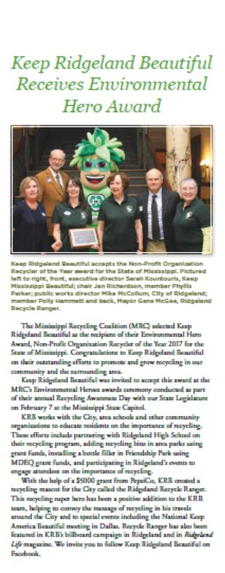
City Publication
Recycling Coalition
Digital Bill Board/Social Media

Slide 13
Funding
MDEQ Solid Waste Grant
Competitive
Population Determines how much money you can apply for:
0-25,000- $25,000.00
25,001-50,000 $50,000.00
50,001 and over $75,000.00
Link to DEQ Website: http://www.deq.state.ms.us/mdeq.nsf/pdf/SW_Grant2a/$File/GRANT_2a%20Revised.pdf?OpenElement
Keep America/Mississippi Beautiful
Mississippi Recycling Coalition

Slide 14
The End
Mike McCollum, Public Works Director
City of Ridgeland
P. O. Box 217
Ridgeland, Mississippi 39157
601-853-2027
Mike.mccollum@ridgelandms.org
www.ridgelandms.org

